Slide 1

Foundations of Effective Database Design Balancing Integrity, Performance, and Scalability

Slide 2

CORE DESIGN PRINCIPLES
Data Integrity: Ensuring accuracy and consistency (Entity and Referential integrity).
Reduced Redundancy: Minimizing duplicate data to save space and prevent errors.
Scalability: The ability to handle growth without a total redesign.
Security: Restricting access via schemas and permissions.

Slide 3

The Challenge of Complexity
The "Trade-off" Trap: High performance often conflicts with high data integrity.
Maintenance Hurdles: Complex designs require specialized knowledge (DBAs).
Rigidity: Once a schema is "set in stone," changing it can break connected applications.

Slide 4

Deep Dive: Data Normalization
Concept: The process of organizing data to minimize redundancy and dependency.
The Goal: Isolate data so that additions, deletions, and modifications can be made in just one table and then propagated through the rest of the database via defined relationships.
Why it Matters: Without it, "Update Anomalies" occur (e.g., changing a customer's address in one place but not another).

Slide 5

The Stages/STEPS of Normalization
3NF (Third Normal Form): Meet 2NF and ensure no "transitive dependencies" (non-key columns shouldn't depend on other non-key columns).
2NF (Second Normal Form): Meet 1NF and ensure all non-key columns depend on the primary key.
1NF (First Normal Form): Eliminate repeating groups; ensure each cell has a single value.

Slide 6

Evidence of Normalization Benefits
According to Coronel and Morris (2019), normalization is essential because it eliminates Data Anomalies.
In an unnormalized system, deleting a "Course" might accidentally delete a "Student" because they share the same row. Normalization separates these entities, preserving data history even as relationships change.

Slide 7

Design Challenges: The Performance Hit
The Downside of Normalization: As you break tables apart (normalize), the database must perform more JOIN operations to retrieve data.
Consequence: High-level normalization can slow down read-heavy systems (like a website's product catalog).
The Solution: Sometimes designers use "Denormalization"—purposefully adding redundancy back in—to boost speed.

Slide 8

Conclusion: The Modern Database
Effective design isn't about following one rule perfectly; it’s about choosing the right tool for the job.
Whether using SQL (Relational) or NoSQL, understanding how data relates is the key to longevity.

Slide 9

Thank you
Gordon Elliott Williams
Post University
BIA575_30 Data Storage methods 2025-26 Term 4
Unit 3 Discussion Board: Database Design Principles PowerPoint
Dr. Michael Saxton
Due February 5, 2026

Slide 10
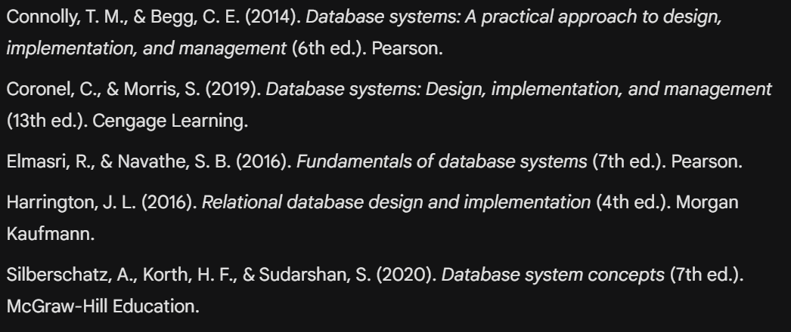
REFERENCES

